Slide 1
CNN update & DDPG

Slide 2
Updates on Environment
Gradient:
f_gaussian = gaussian+ noise
CNN:
A* gaussian + A*noise
where A=random int(3000, 493000)

Slide 3
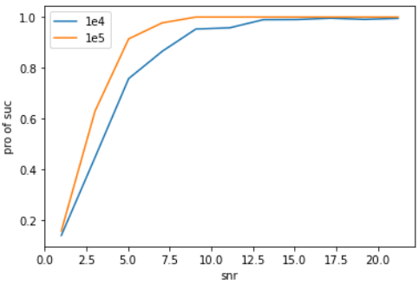
Pro of success v.s. snr

Slide 4
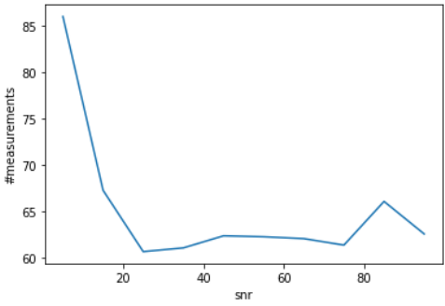
Assessment v.s. snr

Slide 5
What is DDPG
Deep Deterministic Policy Gradient
learn continuous control
deep neural networks
actor-critic approach

Slide 6
Why DDPG?
Continuous space
Actor – critic strategy makes it faster

Slide 7
How DDPG work in Autofocus---strategy
Actor: use neural network to choose the focus center and radius
Critic: use neural network to estimate noisy gaussian and offer advice for Actor
Memory: the actor’s experience is stored in a replay memory, which is used to train the Actor and Critic

Slide 8
How DDPG work in Autofocus---detail
1. both actor and critic use 4 layers network
2. distance to the maximum is not shown to both actor and critic
3. reward function is as reward_factor * intensity, where reward_factor = 100
4. actor has four action to choose:
Center(x, y, z) and radius
In each iteration, actor pick up a random point in the sphere and regard this as the next searching center
Could use grid search/Could use hash method, add one dimension to action-----can be optimized

Slide 9
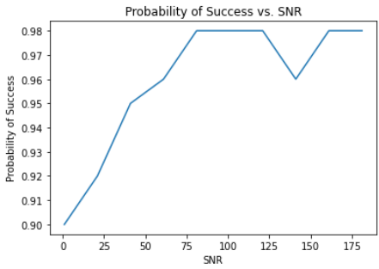
How’s the output?
100 measurements
Not so well, but powerful in low snr
Fail in More Measurements:
1. random 2.use recorded maximum as output 3.lost direction exp(noise)

Slide 10
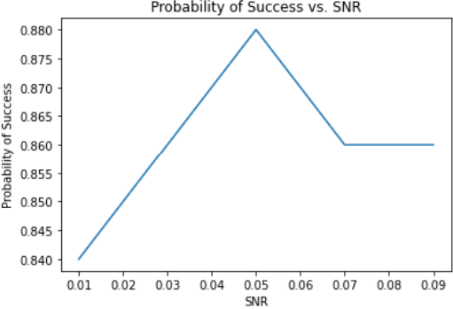
DDPG’s performance in low SNR
100 measurements

Slide 11
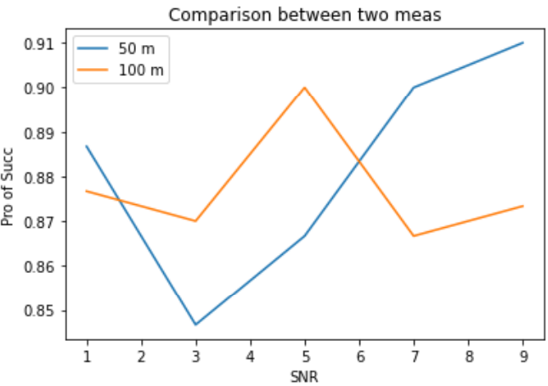
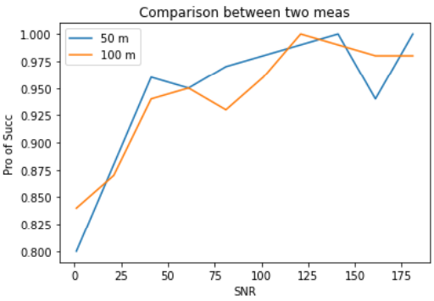
DDPG needs lower measurements

Slide 12
Exploring Experience
Like gradient search, without a sphere
fail

